Slide 1

BURFORD SCHOOL PHONICS 2022-2023

Slide 2
The official guidance in England:
Teachers should use Systematic Synthetic Phonics programmes and ‘cumulative’ decodable reading books for beginners
Why is it ‘synthetic’ phonics?
Synthesising = sounding out and blending the sounds to read the unknown words

Slide 3

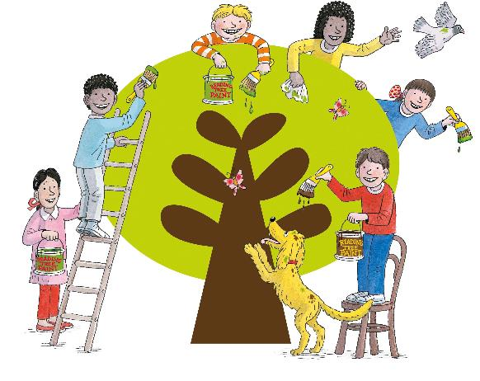
Click to hear audio
Our school uses the
Oxford Reading Tree
Floppy’s Phonics programme
By Oxford University Press
and Debbie Hepplewhite
Floppy’s Phonics is designed to:
inform parents and carers routinely and fully about their children’s reading, spelling, handwriting and vocabulary development
aspire to work in partnership
Notes:
This includes the teaching of reading, spelling, handwriting and language development.

Slide 4
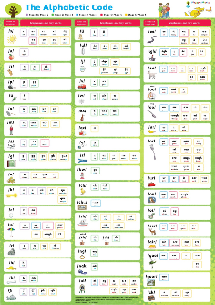
A two-pronged approach to synthetic phonics teaching and learning
Systematic:
Planned
incremental
phonics
programme
Incidental:
individual
group
class
- as needed
Ever-present
Alphabetic Code Chart
Notes:
[Read from the slide.]

Slide 5
The Alphabet
and
The Alphabetic Code
What is the difference ?
Notes:
We all know what we mean by ‘the alphabet’ but what do we mean by the ‘alphabetic code’?
If I asked you to write ‘The Alphabet’ you would all know exactly what I mean and it would probably take you between 12 and 15 seconds.
If I asked you to write the ‘Alphabetic Code’ you might wonder what I was talking about!

Slide 6
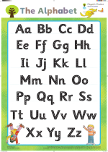
What role does the alphabet play?
1) Bank of letter shapes
2) Alphabetical order relayed
by letter names (ay, bee, see)
by singing a song at first
3) Note that the capital letters
are the same code for speech
sounds as the lower-case letters (/a/ /b/ /k/)
Notes:
Be aware that if children are mainly exposed to capital letters through an alphabet poster whilst saying the names of the letters, they may think of capital letters by names and not their sounds.
So, capital letters are the same code for the sounds as lower case letters. For example, /a/ b/ /k/ and so on.
In the Floppy’s Phonics Sounds and Letters programme, letters and words are shown on writing lines to support correct letter formation.

Slide 7
We don’t use letter names to teach
reading or spelling.
Spelling is a sound-to-print process
– even for adults.
We turn speech sounds into letters and
letter groups (encoding) when writing.
Letter names are used only for relaying a precise spelling,
letter by letter (by letter name) from one person to another.
Notes:
When we teach early reading and spelling, we don’t use letter names.

Slide 8
What is the alphabetic code?
Allotting letter symbols for the smallest sounds of speech is the basis for creating a spelling code - enabling us to communicate through writing.
Translating the letter symbols into sounds is the basis for reading.
We can show this visually on a chart
to make the alphabetic code tangible.

Slide 9
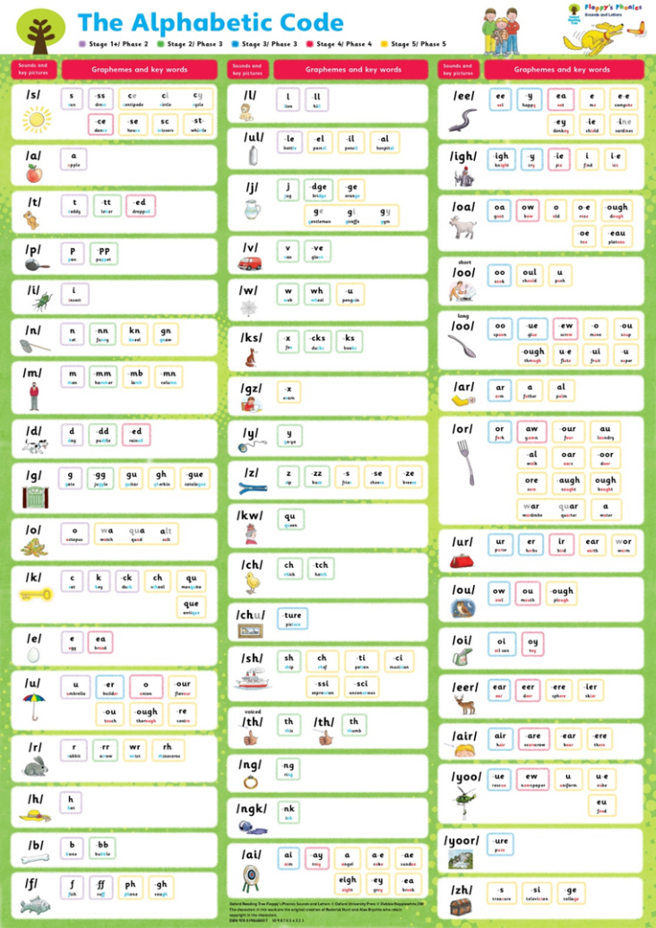
Graphemes
or spelling
alternatives
- across the rows
Sounds
- down the left
columns because
there are fewer
sounds than
graphemes
Notes:
The Floppy’s Phonics Alphabetic Code Chart lists the sounds in the order in which they are introduced in Level 1+ to 3 which helps with the organisation of teaching the programme and links all the graphemes to the sounds.
The borders around the graphemes and word examples are colour-coded like other FP resources.
The Alphabetic Code Chart is the heart of the FP programme and important for both systematic and incidental phonics teaching.

Slide 10
Graphemes
or spelling
alternatives
- across the rows
Graphemes are letters or letter groups
that are code for the sounds:
e.g. sound /ai/ acorn, aid, play, cake,
grey, sleigh, straight
The ‘sounds’ are the ‘phonemes’,
these are the smallest sounds of speech
that change the meaning of a word:
e.g. /b/ /oa/ /t/ compared to /k/ /oa/ /t/
Some ‘sounds’ are two phonemes combined:
e.g. letter x in ‘fox’ is code for two phonemes /k+s/
Sounds
(phonemes)
- down the left
columns
There are around 44 phonemes in the English language
but 50 ‘units of sound’ on the FP Alphabetic Code Chart.
Notes:
The Floppy’s Phonics Alphabetic Code Chart lists the sounds in the order in which they are introduced in Level 1+ to 3 which helps with the organisation of teaching the programme and links all the graphemes to the sounds.
The borders around the graphemes and word examples are colour-coded like other FP resources.
The Alphabetic Code Chart is the heart of the FP programme and important for both systematic and incidental phonics teaching.

Slide 11
The three complexities of the alphabetic code:
One sound can be represented by one, two, three or four letters.
One sound can have many spelling alternatives.
One grapheme (letter or letter group) can be code for different sounds.
(That is, can be pronounced differently!)

Slide 12
Examples of three complexities:
One sound can be represented by one, two, three or four letters;
e.g. bat sheep hair eight
One sound can be represented by more than one spelling alternative, sometimes many!
e.g. The sound /or/ can be written as: or, aw, our, au, al, oar, oor, ore, augh, ough, (w)ar, (qu)ar, (w)a
One grapheme (letter or letter group) can have different pronunciations;
e.g. ‘ea’ eat, bread, break
‘ear’ fear, bear, earth, heart

Slide 13
There are around 24 consonant phonemes – some of which we combine to make further units of sound:
/s/ /t/ /p/ /n/ /k/ /h/ /r/ /m/ /d/ /g/ /l/ /f/ /b/ /j/ /y/ /w/ /z/ /ng/ /v/ /ch/ /sh/
voiced /th/ unvoiced /th/ /zh/
/k+s/ /g+z/ /u+l/ /ng+k/
/k+w/ /ch+u/ combined sounds
Notes:
[Continue to say these sounds noting how quiet they are in comparison to the vowel sounds.]
With ‘combined sounds’, there are around 50 units of sound to be taught – not 44.
[Make sure that parents do not add the ‘schwa’ ‘uh’ when saying the consonant sounds e.g. ‘suh’ instead of /s/ and ‘kuh’ instead of /k/ and so on.]

Slide 14
The ‘volume’ in spoken words is provided by the 20 or so vowel phonemes some of which we combine to make further units of sounds:
/a/ /e/ /i/ /o/ /u/ /ai/ /ee/ /igh/ /oa/
short /oo/ long /oo/ /ar/ /or/ /ur/ /air/ /eer/ /oi/ /ou/ /oor/
/y+oo/ /y+oor/ combined sounds
Notes:
This is a good time to ‘say all the sounds’ along with all the parents.
[Make sure you draw attention to the ‘schwa’ ‘uh’ when saying the consonant sounds e.g. avoid saying ‘suh’ instead of /s/ and ‘kuh’ instead of /k/ and so on.]

Slide 15
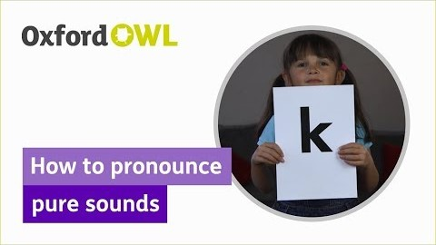
Click here for an audio guide to say the phonics sounds: https://cdn.oxfordowl.co.uk/2016/05/05/20/22/32/561/20097_content/index.html?id=ae
Click here for a video on how to pronounce pure sounds:
https://www.youtube.com/watch?v=UCI2mu7URBc
Notes:
This is a good time to ‘say all the sounds’ along with all the parents.
[Make sure you draw attention to the ‘schwa’ ‘uh’ when saying the consonant sounds e.g. avoid saying ‘suh’ instead of /s/ and ‘kuh’ instead of /k/ and so on.]

Slide 16
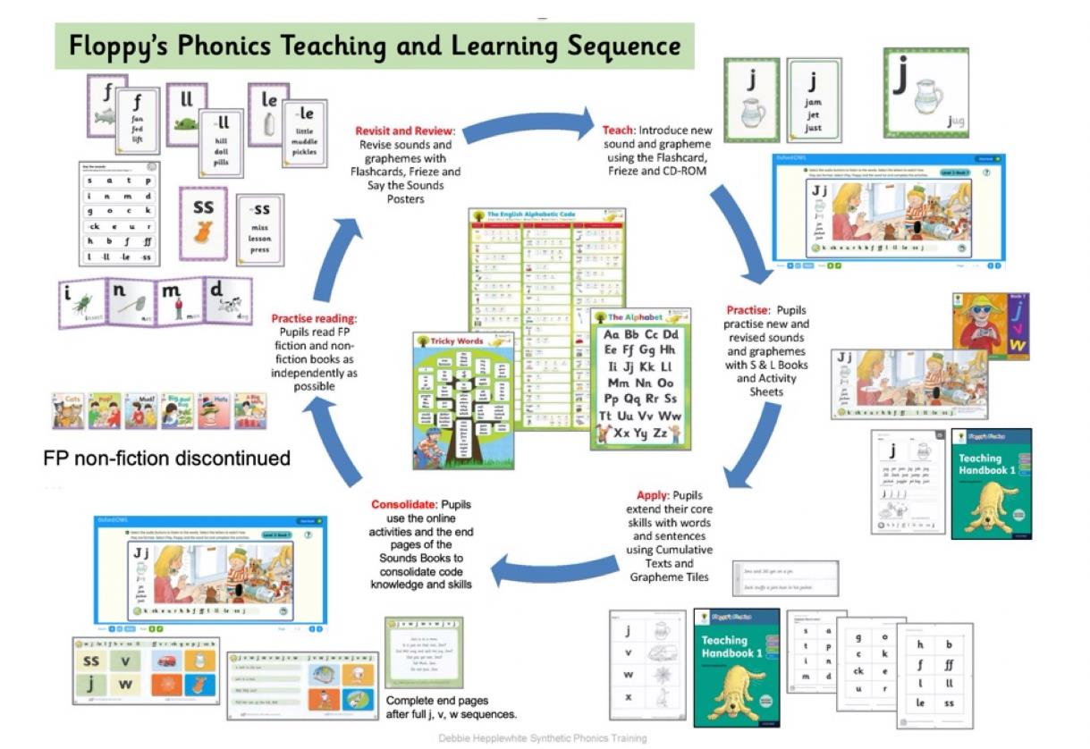
Teaching and Learning Sequence
Click to hear audio
CD-ROMS have been replaced by an online subscription platform accessible from home.

Slide 17

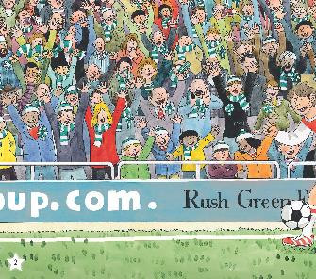
Pre-phonics
Sounds:
environmental
rhythm, rhyme
singing, chanting
percussion, music
discussion!
oral blending and segmenting (phonics sub-skills)
Notes:
At first we focus on activities and conversations to develop children’s awareness of what is meant by ‘sound’.
These books can be used flexibly if required – for example, for extra opportunities to talk one to one or in small groups for children with speech and language difficulties, for children with English as a new or additional language.

Slide 18
Oral blending and oral segmenting
1. Sub-skill of reading without letters:
Say, “Pull up the /z//i//p/ of your /c//oa//t/.”
2. Sub-skill of spelling without letters:
“Mat, /m/ /a/ /t/. Spoon /s/ /p/ /oo/ /n/.”
This helps your child’s awareness of sounds.
Notes:
Parents can help to train children in their awareness of sounds of speech.
Make up games where you are training your child’s ‘ear’ to ‘hear’ the words from the separate sounds which is a sub-skill of reading – and to break up whole spoken words into their constituent sounds which is a sub-skill of spelling.
Notice that, for the reading sub-skill, you start with the separate sounds of the words then say the whole word (your child can start to discern the whole word).
For the spelling sub-skill, you say the whole word first followed by saying the separate sounds and eventually the child will be able to do this.

Slide 19
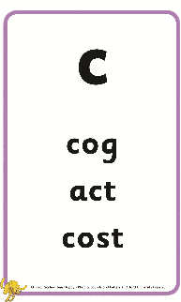
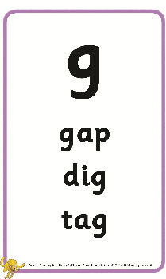
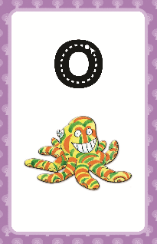
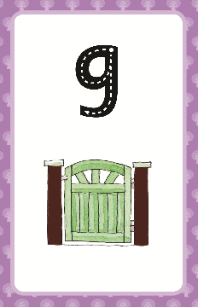
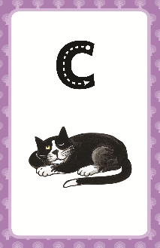
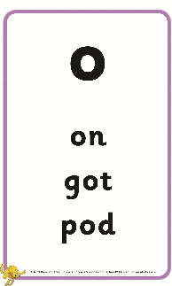
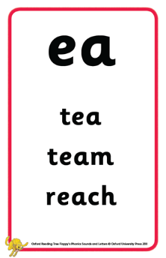
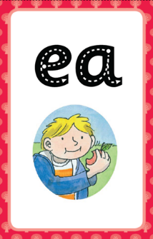
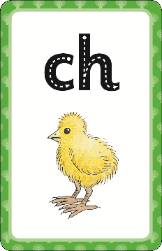
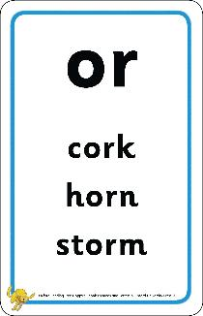
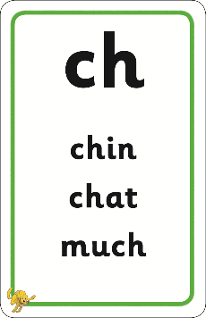
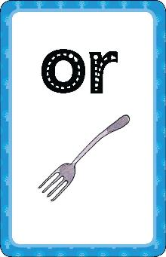
Alphabetic Code Flashcards
Notes:
Finger trace the grapheme whilst saying the sound of letter groups, not individual letters (e.g. /ch/ not /k/ /h/). Say the prompt picture-word slowly to recall the focus sound.
There are cumulative words on the back of each card for reading and spelling with the focus letter/s-sound correspondence in all positions. Shorter and longer words are included. They provide printed words for quick blending practice and the printed words equip the teacher to provide spoken words for oral segmenting and spelling. [Quickfirst ‘revisit and review’]
All the resources are colour-coded and numbered to help with the progression throughout the programme and organisation of the resources. Consider having two sets of the Flash Cards – one for the teacher’s use and the planned phonics sessions, and a set for building up over time for ‘continuous provision’ for the children to play with.

Slide 20
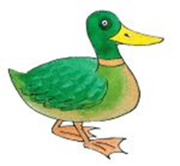
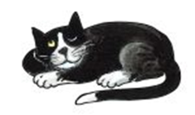


Mnemonic picture-words
/k/
c a t k ey d u ck
‘Mnemonic’ means ‘aid to memory’.
Picture-words and their printed words make the learning of the different sounds and spellings more memorable and manageable and can clarify the teaching and learning for adults and children alike.
Notes:
Take a close look at the FP Alphabetic Code Chart and the attendees’ mini alphabetic codes.
Why is the letter ‘k’ used to denote the sound instead of a ‘c’?
A mnemonic system is an ‘aid to memory’.
Say the key picture very slowly indeed (take a deep breath first) and the first sound /k/ pops out followed by the /ee/ sound. So, at first, the picture prompts the focus sound. Later, the focus sound and grapheme may be within or at the end of a word.
The printed words provide examples of the focus letter/s-sound correspondence in the context of a real word.

Slide 21

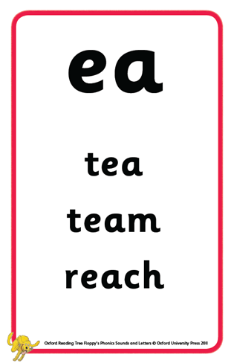
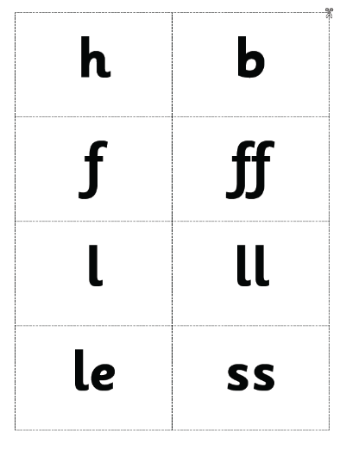
Resources to teach the alphabetic code:
Grapheme Tiles and Flash Cards
‘See the graphemes and
say the sounds’ is a
sub-skill of reading.
Notes:
Various resources support learning letter/s-sound correspondences to AUTOMATICITY.
Teachers can use some different core resources whilst the children practise the same skills.

Slide 22
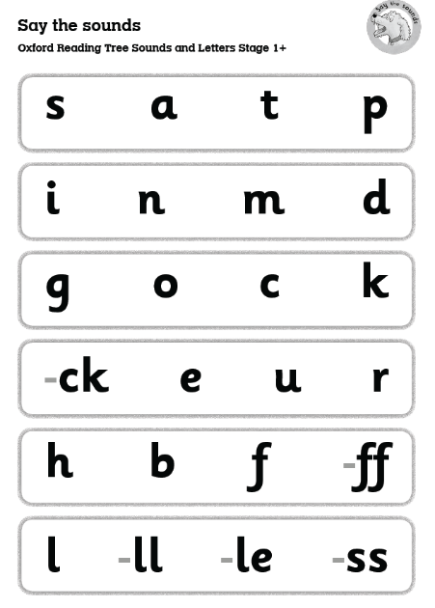
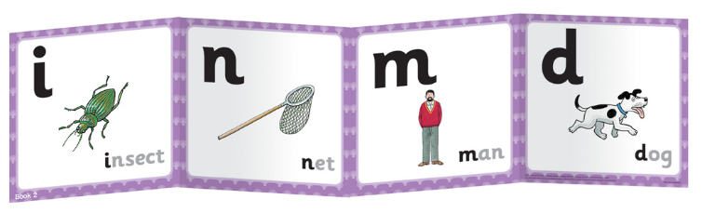
‘Say the Sounds’ Posters and Frieze
The frieze matches the code order in the Sounds Books.
Some ‘Say the Sounds’ posters match the order and some are in ‘jumbled’ order.
‘Point to the graphemes and say the sounds’
is a sub-skill of reading.
Notes:
All of these resources support learning letter/s-sound correspondences to AUTOMATICITY...
Remember - From print to sound for reading – from sound to print for spelling.
When the Say the Sounds poster comes home in the phonics folder in the bookbag, the sounds can be practised at home.

Slide 23

‘Hear the Sounds’
‘Hear the sounds and
point to the graphemes’
is a sub-skill of spelling.
“Air-write
/d/, /h/, /k/.”
Notes:
We can use the Say the Sounds Posters for the sub-skill of spelling too. The adult says the sounds, and the pupils point to the graphemes, or air-write the letters and letter groups.
[Point under some graphemes for the parents to say the sounds. Then, in reverse, you say the sounds /d/, /h/ and /k/ and ask the parents to air-write the graphemes. When it gets to the /k/ sound, there needs to be greater clarity about ‘which’ /k/? Follow this with the next slide which explains.]
But how will the children know which grapheme to write for the /k/ sound?

Slide 24
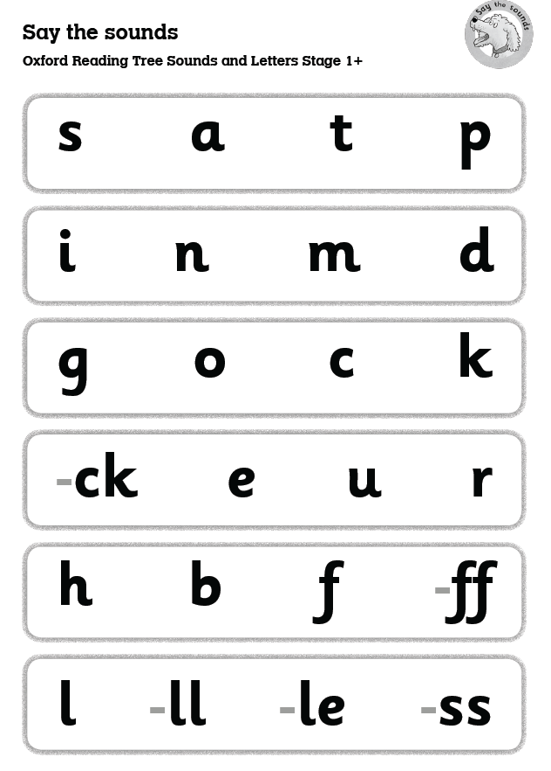
‘Hear the Sounds’
“Which /k/?”
“The /k/
as in cat,
the /k/ as
in duck...”
Notes:
The mnemonic system for the spelling alternatives is invaluable and it extends throughout the alphabetic code and the FP programme (and the PI programme) – not just for prompting the sounds, but also for providing examples of words for the spelling alternatives.

Slide 25

Decoding
Study the printed word from left to right to recognise any ‘letter groups’
Finger-track under each grapheme (letter or letter group) from left to right whilst saying each sound
Run your finger right under the whole printed word, from left to right, when you say the whole word
Notes:
For decoding, study (scan) the printed word before sounding out and blending – because the ‘reader’ needs to see if there are any ‘letter groups’ to consider for the sounding out and blending process.

Slide 26


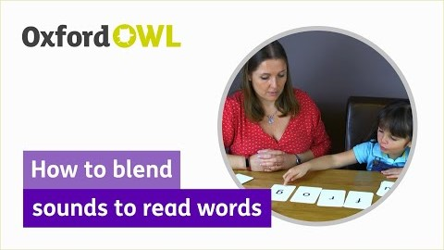
Decoding
Study the printed word first – looking for letter groups!
stick
/s/ /t/ /i/ /k/ “ stick ”
Video: How to blend
sounds to read words:
https://www.youtube.com/watch?v=vqvqMtSNswo
Notes:
Teach this routine well to the children. Point under, or tap under, each letter and letter group from left to right.
Run your finger under the whole word which allows a ‘moment’ to say the whole spoken word.
All the staff need to use the same phonics hand routines.

Slide 27

Spelling-with-editing routine
Face the same way as your child
Left hand, palm facing – make sure your child sees your hand ‘on the left’
Say the word to be spelt, very slowly – the individual sounds will ‘pop out’
Tally the sounds onto thumb and fingers
Repeat each sound separately and clearly
Then count how many sounds
Notes:
All the staff can practise this routine and do it the same as one another. Remember not to face the children because the children need to see modelling in the same way as they do the tallying themselves.

Slide 28
Spelling-with-editing routine
Model how to write the ‘sound dashes’ top left of the page, from left to right
The sound dashes double-up as writing lines
Write the graphemes on the lines whilst engaging the child to call out the sounds as you write
Then sound out and blend to check the word (engage your child to say the sounds without you as soon as possible)
Confirm if the word is spelt correctly
Notes:
Sound dashes should be long enough for more than one letter, and have only small spaces between each dash.

Slide 29
Sound dashes / writing lines
s oa p
soap
Check letter formation too!
✓
Blend to check
the spelling
Notes:
When the children are being taught joined handwriting, still use ‘print letters’ for the sound dashes, then fully joined writing for the whole word written beneath.
This is scaffolded spelling – not invented spelling, or ‘phonically plausible’ spelling.
In the FP phonics routines on the Activity Sheets, children cannot tick their own spelling until the adult has verified that it is correct. Check the spelling on the sound dashes for confirmation. Then tick. Then write the whole printed word.

Slide 30
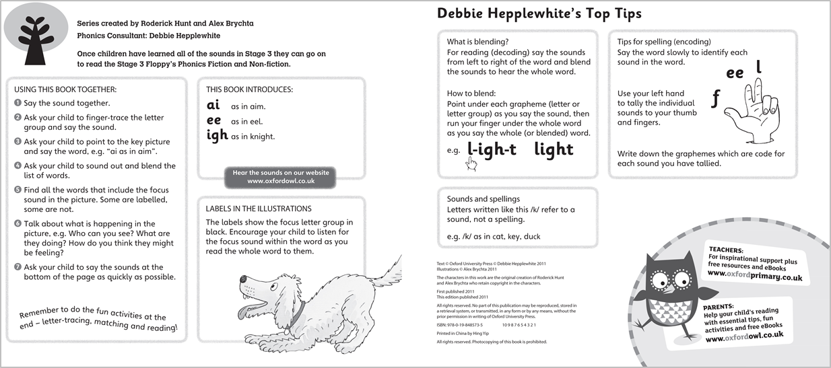
Cover notes in the Floppy’s Phonics Books provide guidance for the adult to support the young reader
to blend and segment:
Blending routine
for reading
Segmenting routine
for spelling
Notes:
Many current UK cumulative decodable reading books provide explicit guidance for the supporting adults in the cover notes for blending.
The FP Sounds Books give guidance for both blending and segmenting for spelling.

Slide 31
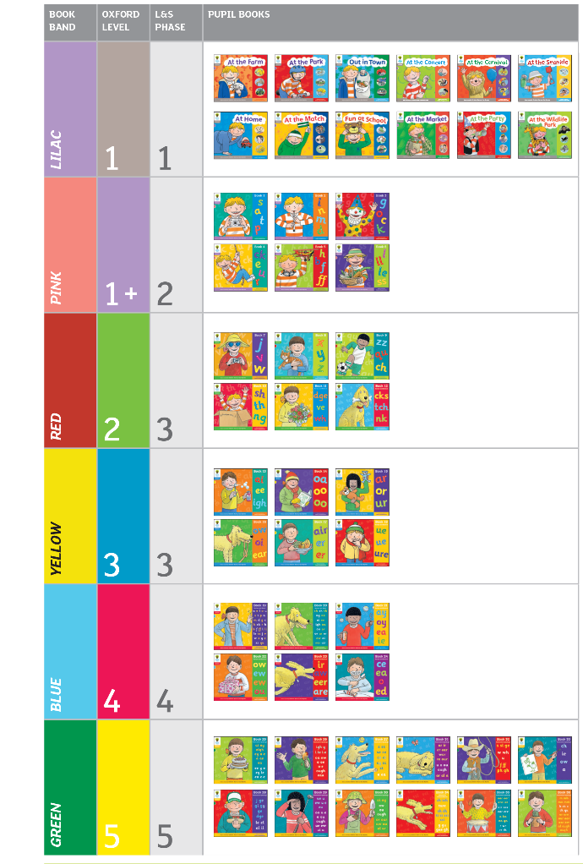
48 Sounds Books
6 level 1 ‘cloud books’ not interactive
When letters and sounds are introduced, the books are numbered Book 1, Book 2, Book 3
(36 numbered books)
Click to hear audio
Notes:
There are 48 beautifully illustrated Sounds Books - phonics teaching and learning books – the original 42 books have matching spreads via the web-based interactive resources.
The Level 1 books – you could call them the ‘cloud’ books because of the white cloud-like shape around their titles – are matched to phase 1. These focus on ‘sounds’ and do not introduce letter shapes. Only the first ‘original’ 6 titles are featured on the interactive platform.
Letter shapes and phonemes are introduced in Sounds Book 1 at Level 1+. This and subsequent books are numbered as they feature the systematic introduction of the letter/s-sound correspondences of the alphabetic code. So the Sounds Books with letters are numbered 1 to 36.
Let’s look at the ‘systematic, planned programme’ to consider the possible pace for introducing the letter/s-sound correspondences:
With a slow, steady, planned pace of introducing the correspondences in one book even over two weeks, an extensive alphabetic code (as on the FP Alphabetic Code Chart) can be introduced over two years.
This allows for masses of consolidation and revision – and incidental teaching as required – for reading, spelling and writing. The slower, steady pace with lots of practice and embedded learning reduces the likelihood of children getting quickly left behind their peers – and increases the likelihood of all children succeeding.
With spelling and writing, this programme is appropriate for Year Two as well. Teachers need to decide when to actually ‘start’ to use the programme – this could be Reception, or Year One, or in some cases, Year Two teachers might find this suitable starting at an early stage in the programme. This is particularly the case when FP is used in contexts where children are taught English as an additional language – and FP can be used with older, hearing impaired children very successfully as there is so much emphasis on new vocabulary and language comprehension – not just learning ‘the code’.

Slide 32
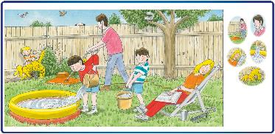
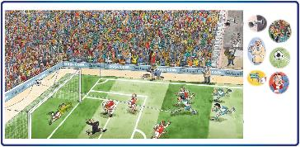
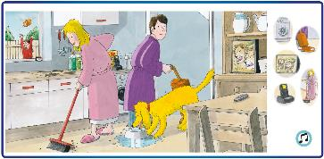
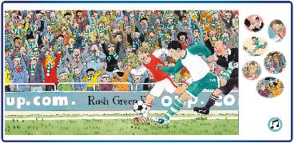
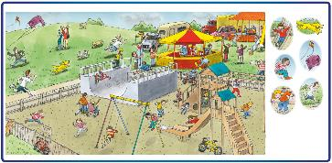
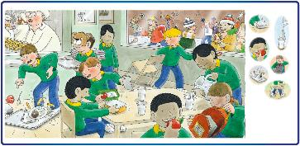
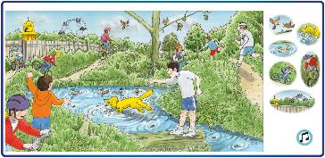
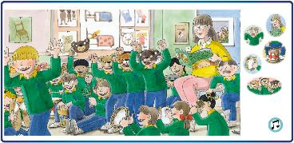
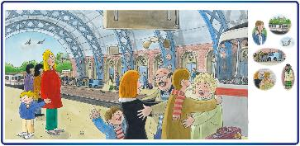
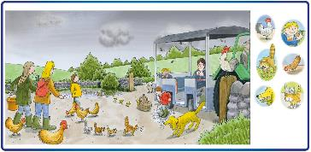
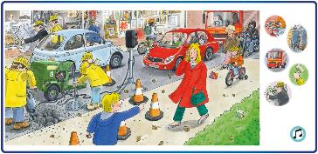
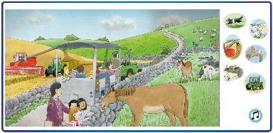
Print-rich and Picture-rich:
oral language - not ‘just’ phonics
AtAt
At Home
At the Match
At the Park
Fun at School
Out in Town
At the Farm
Notes:
Floppy’s Phonics is truly picture-rich throughout the programme. The first books (the ‘cloud books’ or ‘Phase one’ books) do not introduce letter shapes but provide appropriate early years themes to develop speaking and listening – along with children engaging with the characters enjoying experiences in many different venues.
Developing children’s spoken language is essential and this also supports children’s reading capacity not just their speech.
Use these for nursery-aged children and also in Reception and for children with language problems. Use them in Reception, if required, alongside ‘Book 1’ of the FP programme – introducing letter shapes and sounds from the beginning of Reception. Don’t ‘wait’ to have completed the cloud books first.

Slide 33
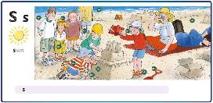
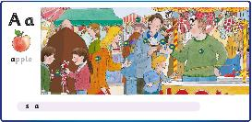
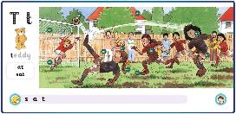
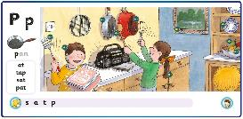
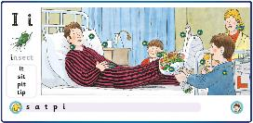
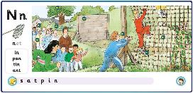
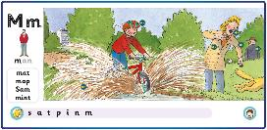
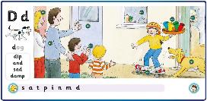
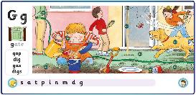












Examples of
Illustrations
Sounds Books:
162 full illustrations
Interactive Platform:
144 full illustrations
(21 of 144)
Picture-rich:
Oral language plus phonics examples in memorable contexts
Notes:
Floppy’s Phonics has an outstanding range of full colour illustrations in addition to many other simpler pictures throughout the programme.
These rich illustrations serve to develop oral language – masses of speaking and listening opportunities – building up a rich vocabulary and oracy.
In addition, the illustrations serve to introduce and embed the letter/s-sound correspondences of a very complex alphabetic code and spelling system, providing word examples for both reading and spelling.
This addresses both the technical code-based processes needed to be a reader, and the language comprehension needed to be a reader – as in the Simple View of Reading model.
The focus letter/s-sound correspondences are more memorable when linked to specific words exemplified by the characters and their activities in the pictures.
Over time, children are also supported in recalling ’spelling word banks’ through the words and illustrations in the Floppy’s Phonics programme.

Slide 34








Inside the Floppy’s Phonics Books
These pages are on the digital platform
with audio
These ‘end pages’ are not
on the digital platform
Notes:
The ‘cover notes’ in the structured phonics books describe the blending for reading and the segmenting for spelling routines.
The main pages (sometimes four double-page spreads, sometimes three) introduce the letter/s-sound correspondences – these have correlating spreads on the interactive platform.
The end pages (bottom row on the slide) allow for revision and consolidation of the learning for: recognising the graphemes, handwriting, reading, writing, drawing – the children can use personal exercise books to extend their writing and drawing activities. These end pages are not included on the interactive platform.

Slide 35




Phonics sub-skills and skills Activity Sheets
Teaching Handbook 2 – Level 5
Essential – extend practice to Cumulative Texts as part of the ‘teaching and learning sequence’
Teaching Handbook 1
Notes:
Multi-sensory Activity Sheets are provided throughout the programme. These are essential for every individual child to get a proper opportunity to learn the core knowledge and skills.
These paper-based, content-rich Activity Sheets give children ownership of their work and engage them with a sense of their own learning and progress. Children are trained to mark and annotate their own work in pencil – ticking, circling, underlining – and adults mark and annotate (and acknowledge achievement) in pen.
For applying and extending their new learning, Cumulative Texts are provided from the ‘ck’ grapheme onwards – that is, to correspond with the Sounds Book number 4.
The Activity Sheets and other paper-based activities are collated in each child’s phonics folder to go back and forth ‘to home’ in the school’s bookbag routine. More about this later.
Here is some guidance about the importance of the phonics folder shared with home if possible (resources shown are from the Phonics International programme but this is the same rationale as for Floppy’s Phonics):
https://phonicsinternational.com/Setting_up_the_phonics_folder.pdf

Slide 36




Multi-sensory practice and application
Grapheme Tiles
and
Picture Tiles
Activity
Sheets
1 to 134
Say the Sounds
Posters
Cumulative
Texts
From ‘-ck’
Notes:
These photocopiable multi-sensory activities give children plenty of opportunity to learn the code and then to apply their learning to word banks and to Cumulative Texts. These are all shared with parents and carers at home via the children’s own ‘phonics folders’ going back and forth to home in the school’s ‘book bag’ routine.
These resources are an essential part of the programme.
The activities need to be completed in school and some are ideal for repeating at home and, as a minimum, they inform parents and carers routinely about the school’s phonics provision and their children’s progress.
Grapheme Tiles are great for early spelling – that is, for beginners, and for intervention purposes. Once children can handwrite, grapheme tiles are not necessary and can be used for continuous provision activities such as word-building.

Slide 37


Example Word List of Six Words
Level 5
Sounds Books
Introduce new
l/s correspondences
in their key word examples
Level 5
Activity Sheets
Provide spelling word banks of focus
spelling alternatives
Notes:
The spelling alternatives on the right-hand pages in the Level 5 Sounds and Letters Books provide one example word.
On the parallel Activity Sheets, however, there are six example words for all the alternative spellings – and this is part of building up awareness and knowledge of spelling word banks and which words are spelt with which spelling alternatives.
You and/or the children may be able to add words to these spelling word banks.

Slide 38



Say the Sounds Strips
Repetition embeds the learning
Notes:
There are ‘say the sounds’ strips in the Sounds and Letters books, on the CD-ROMs, on the Activity Sheets and on the Say the Sounds Posters – resulting in far more repetition than just the teacher going through the grapheme Flash Cards routine.
Children can practise the routines independently and repetitively – not dependent upon the teacher – and they can practise ‘at home’.
Little and often practice significantly improves learning to automatic levels.

Slide 39

Vocabulary, Phonics and Building Spelling Word Banks
Phonics for reading and spelling linked to
wider language, memorable pictures and story themes
Notes:
Here we have a great example of how the phonics teaching for both reading and spelling can be linked with the spoken language, comprehension and exciting story themes.
Ultimately, for spelling many words, the learners need to recall spelling word banks stored permanently in memory such as the ‘al’ words and the ‘il’ words above. A story theme and picture can help children to recall spelling word banks.
Children can work in pairs to think of a few sentences to include the feature words (only one set at a time, for example, the ‘al’ words) and to match the feature illustration. Tell them the precise number of words they are recalling for a specific ’spelling word bank’. ”Today we are learning the 8 words in the ‘al’ spelling word bank.” When they’ve worked out a brief story theme with the focus words in the bank, cover over the picture, and ask the children to repeat their story to recall the words in the ‘al’ word bank. Ask them the following morning. Make it very clear to children that, for spelling, they need to learn how to spell words exactly and this takes a long time and full concentration. In effect, they are ‘building up’ their spelling word bank knowledge – adding to what they know already through their wider reading and writing.
Teachers can also get children to think of ways to ‘act out’ the words from a word bank to help them remember which words are spelt which way. The children will associate the words which they acted out in any one session – so only act out a bank of words of one spelling alternative in any one lesson.

Slide 40



Sample Screen Views: web-based platform
Click to hear audio
Select the letters to watch letter formation
Drag and drop
for spelling
SCREEN
See the letter/s,
say the sounds
Hear the sounds,
point to the graphemes
Blend and reveal
for reading
For use in school and at home,
the teachers will guide your use.
Notes:
These are screenshot examples of the online platform launched in September 2019.
The web-based platform matches the Sounds Books with core phonics skills and their sub-skills.

Slide 41

Let’s take just one sound ... / j /
We see J or j and say /j/ at the beginning of words...
Notes:
At first we teach this letter-sound correspondence using the full range of resources for the phonics teaching and learning sequence.
But consider that both the lower case letter and the capital letter are code for the same sound. It may be highly likely that you have a child or children in your class with a name beginning with the letter ‘J’ and sound /j/. Take care to introduce the capital letter by its sound and not its letter name.
You teach letter names through teaching about the bank of letters in the alphabet and alphabetic order, through singing a song at first and referring to your Alphabet Poster showing letter formation on writing lines.
Note: Keep letter names away from teaching any reading and spelling processes – we only use letter names for relaying precise spellings letter-by-letter to another person.

Slide 42

But what is the code when the sound /j/ is at the end of words?
For reading, we see dge and we say /j/. We never see letter j at the end!
Notes:
Later:
But, when words end with the /j/ sound, they are never spelt with letter ‘j’ in the English language.
When you teach ‘dge’, you can use the Alphabetic Code Chart with the learners to point out that words can also end with this grapheme or ‘-ge’ – but today you’re focusing on ‘this’ grapheme dge.

Slide 43

But wait a minute, some words which start with the sound /j/ don’t always start with this letter: j Is there any code which alerts the reader to this?
Notes:
Later:
But even words beginning with the /j/ sound may not start with letter ‘j’!
This is known as ‘soft g’ by many adults. When reading, the letters e, i or y alert the reader that sometimes the letter g might be pronounced as /j/.
Children need to learn, over time, which words are spelt this way – this is about building up awareness and knowledge of spelling word banks.

Slide 44

Handbooks: Pages 18 to 21 provide alphabetic code information for /j/
How do we know when to use this grapheme [‘ge’] or this
grapheme [‘dge’] for spelling words which end with the sound /j/?
Notes:
Children will encounter words with all these spelling alternatives in their wider reading and writing – and teachers need to know how to address the children’s needs through both their formal planned phonics programme for reading and spelling and as the need arises incidentally which is why Floppy’s Phonics is underpinned by the two-pronged systematic and incidental phonics teaching approach and is truly ‘leading edge’.
However did anyone learn to read and spell in the English language before we taught our English alphabetic code systematically and thoroughly for reading and spelling?
Sadly – many children didn’t which is why there is such weak literacy in English-speaking countries!

Slide 45

Essential MULTI-SKILLS Activity Sheets
Individual practice of the
sub-skills and core skills
for reading, spelling
and handwriting at
word level
Children are fully trained
in the routines – then they
can work at their own
speed independently.
Notes:
Now we’ll show you how much learning can be achieved using the core skills Activity Sheets by trying it out together!
[See the four end slides of this ppt for a suggestion of which Activity Sheet to use alongside the ppt. Provide the parents with an Activity Sheet each and a pencil if possible, and take them through the way the children use them in school. Point out how very ‘core’ and effective these skills’ activities are. Model the finger-tracing for the letter shape whilst saying the sound. Model the finger tracking under the graphemes for sounding out and blending. Model the tallying sounds to thumb and fingers of the left hand, palm facing, for the spelling routine. Count the sounds, write sound dashes on the back of the folded-up part of the Activity Sheet, and say the sounds whilst handwriting the graphemes from left to right. Finish by finger tracking under the graphemes from left to right whilst saying the sounds and blending the word. Is it correct? If so, tick the word.]

Slide 46

HANDWRITING
Write all the upper case (capital) and lower case letter shapes of the alphabet with the correct tripod pencil hold.
“Let me show you again…..”
“Froggy legs with the log under”
“Let me help you...”
Notes:
[Comment that many children hold the pencil down the cone because they get a better grip for tiny fingers – contrary to the ‘small hands need fat pencils’ theory.
We can model the correct pencil hold in a very kind way. “Let me help you”.

Slide 47

Simple, multi-purpose Cumulative Texts:
Work at own speed:
Grapheme search
Decode
Comprehend
Self-dictation
Convert to joined writing
Write extension sentence
Illustrate
Periodic teacher dictation
Notes:
The children apply their focus alphabetic code knowledge to sentences and texts for further basic skills development and comprehension.
Whatever words can be read, can also be used for spelling and handwriting practice.
‘Self dictation’ is when the learner, having read the text, re-reads it and holds each sentence, or phrase, in his or her head and then re-writes in an exercise book with writing lines (preferably). This is a very powerful way of embedding learning and allows children to work at their own speed and capacity. Some children may well accomplish more than others, but that is fine if all children are working according to their potential.

Slide 48

Extension activities are always provided
Different levels of support
Some learners may require additional time and more
‘little and often’ practice

Slide 49
The school’s bookbag routine
The paper-based resources
are constantly added to
your child’s phonics folder
for the bookbag routine.
Parents can then see and
support some of the phonics
work that takes place in school.
Please ‘take an interest’ and
repeat activities at home.
Notes:
Please take an interest in your child’s phonics work. It may be helpful to practise some of it again at home as ‘little and often’ learning helps children to remember.
Give your child plenty of praise for his or her work whatever the level of the knowledge and skill of the child.
If you have any worries about the phonics work, or any questions, please don’t hesitate to contact your child’s teacher.
You can always communicate through your child’s READING RECORD BOOK which is also kept in the bookbag.

Slide 50
How the adult supports the learner to read is very important...
1. Tell the learner the code:
straight In this word, these letters
are code for /ai/.
2. Alternatively, model the sounding out and blending of
the word to the learner.
3. Or simply tell the learner the words which are proving
too difficult.
Notes:
Children will need different levels of support when reading aloud.
There are different ways that the adult can help the learner to read the words.

Slide 51





Click to hear audio
Sounds and letters book
Decodable Texts
Books to share

Slide 52
PLEASE:
Listen to your child read to you and support as needed (AND talk a lot about the story)
Read books aloud to your child
Share the reading of books with your child
Continue to hear your child read aloud even when he or she can read independently
Chatter about everything
Repeat the phonics routines with
the Floppy’s Phonics resources
Notes:
We cannot overemphasise the importance of your child continuing to read aloud and the importance of masses of talking taking place at home.

