Slide 1
Early Years Curriculum
Welcome to the Reception phonics, reading and writing workshop.
Notes:
Keep – fluff up

Slide 2
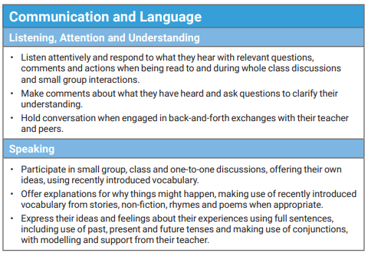
Early Years Curriculum
Early Learning Workshop – Communication and Language
End of year goals –
Notes:
Keep – fluff up

Slide 3
L
Early Years Curriculum
How we support communication and language…
Comment rather then question (“ wow, you are building a tall tower”).
Talk about what the child is doing (“ You have filled the container with sand”).
Pause and wait ( some children need longer processing time).
Use open-ended statements/question (“How do you feel ?…Why did that happen ?… What could we change?... I wonder…”).
Show genuine interest.
Model your thinking (“I think I am going to…”)
Expand and correct vocabulary ( A child might say “the car goed”. The adult should say “yes, the car is going”. A child might say “a big tree”. The adult could say “a huge tree with many brown branches”.)
Tapestry uploads from home to school.
Notes:
keep

Slide 4
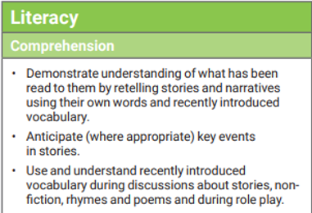

Early Years Curriculum
Early Learning Workshop – Literacy (comprehension, word reading and writing)
End of year goals –

Slide 5
Early Years Curriculum
Reading to children is vitally important…
If a child is read to daily, they will have heard approximately 296,660 words by the time they are 5 years old. If a child is read 5 books a day, they will have heard approximately 1,483,300 words.
Being a fluent and competent reader is the passport to the rest of a child’s education.
Please read a range of texts to your children (fiction, non-fiction and poetry)

Slide 6
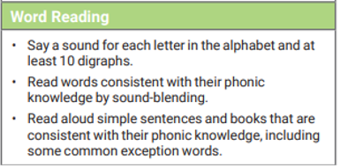
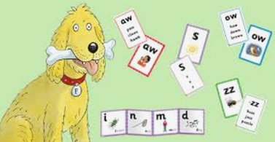
Early Years Curriculum
v
How do we teach children to read?
End of year goals –
Floppy phonics
Sounds
Blending
Application
s a t

Slide 7
Early Years Curriculum
Our sounds…
s | a | t | p | i | n
m | d | g | o | c | k
ck | e | u | r | h | b
f | ff | l | ll | le | ss
j | v | w | x | y | z
zz | qu | ch | sh | th | ng
dge | ve | wh | cks | tch | nk
ai | ee | igh | oa | oo | ar
or
Remember we teach the sound and not the name of the letter.
In reception, we focus on lower case letters.

Slide 8
Early Years Curriculum
Please support with reading at home
We rely on your support to help your children to learn to read.
Please listen to them read everyday.
Little and often is the key to success.
It is a good idea to ask your child to read their school reading book several times in order to consolidate their learning.
Encourage you child to understand what they are reading (question them).
Please note progress in the reading record.
Please support your child to complete their weekly phonics sheets.

Slide 9
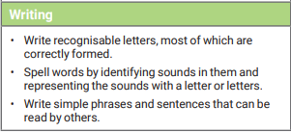
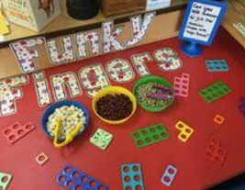
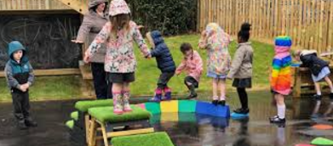
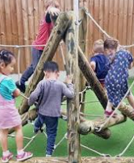
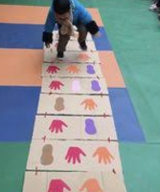
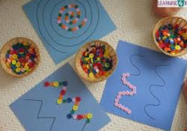

Early Years Curriculum
Early Learning Workshop – Writing
- Gross motor activities
- Fine motor activities
Kinetic letters

Slide 10

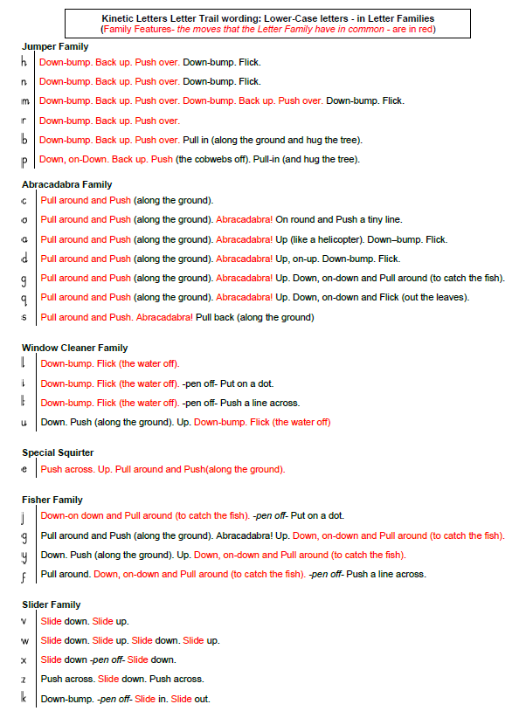
Early Years Curriculum
Handwriting – Kinetic letters

Slide 11
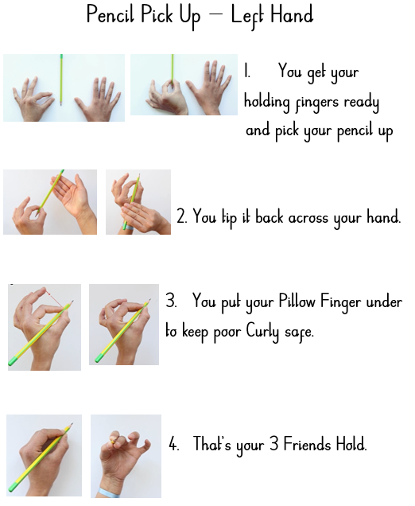
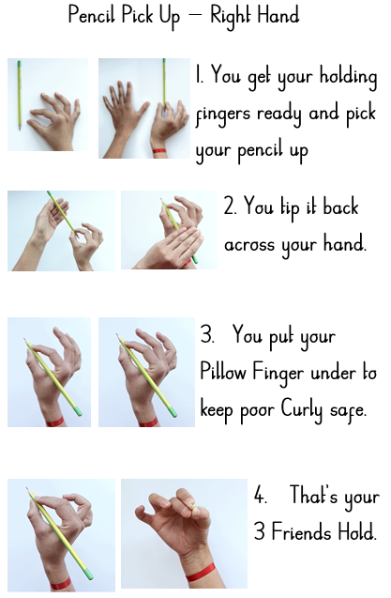
Early Years Curriculum
Writing – correct pencil grip
Notes:
Handwriting programme – kinetic letters

Slide 12

Early Years Curriculum
Early Learning Workshop – Writing
Initial sounds – s a t p i n
CVC words – t a p
Tricky words – I, the, no, my, was, etc…
Full sentences – finger spaces, capital letters and full stops.
Notes:
Examples – model how we introduce this and teach this to children

Slide 13
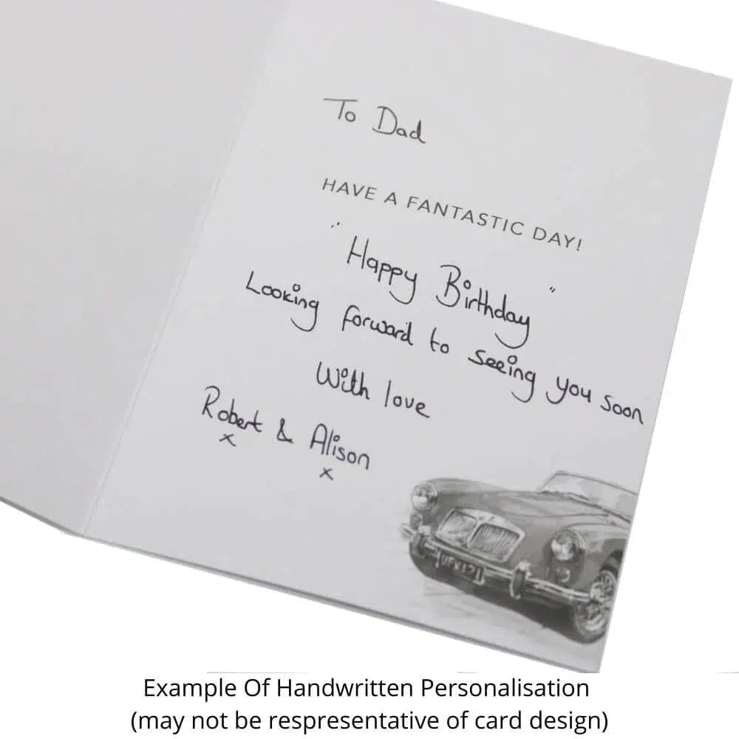
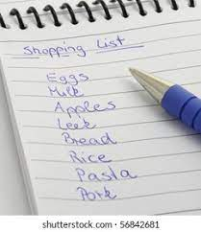
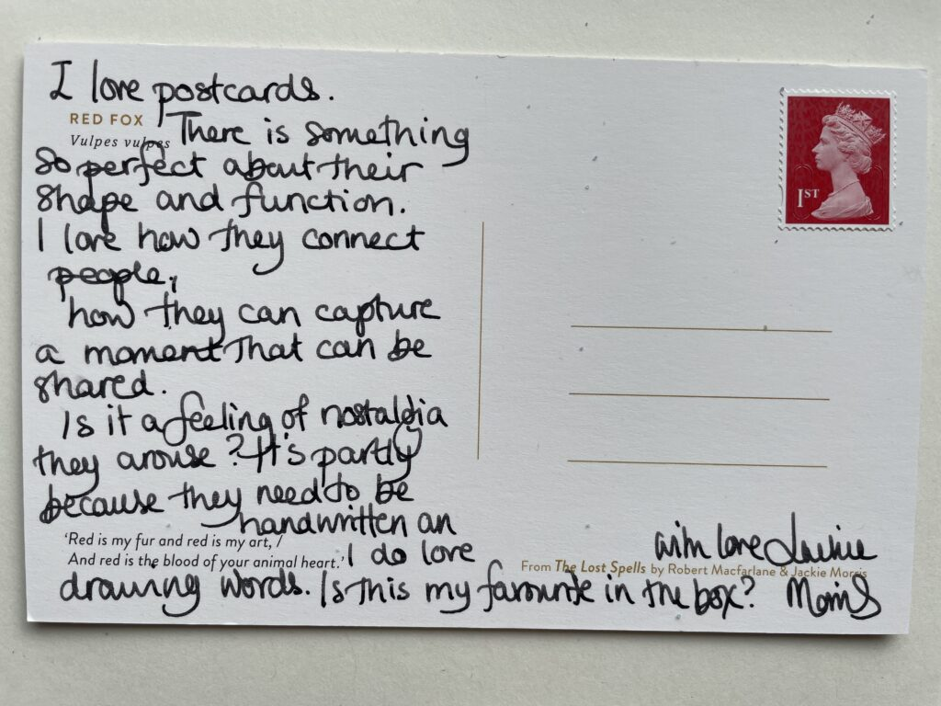
Early Years Curriculum
Remember to model the purpose of writing …
Notes:
Insert shape – shopping list, cards,

Slide 14
Early Years Curriculum
Early Learning Workshop – Activities
Story telling
Matching cvc words
Fine motor activities
Notes:
Finger puppets, teddies, story spoons, natural objects, twinkl story pictures – picture matching – playdoh, cheerios and spaghetti, peg boards, pegs and pom poms
Create a bank of fine motor – for parents and playdoh receipe

