Slide 1


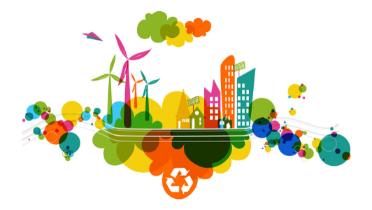
Burford School
Design & Technology Activities

Slide 2
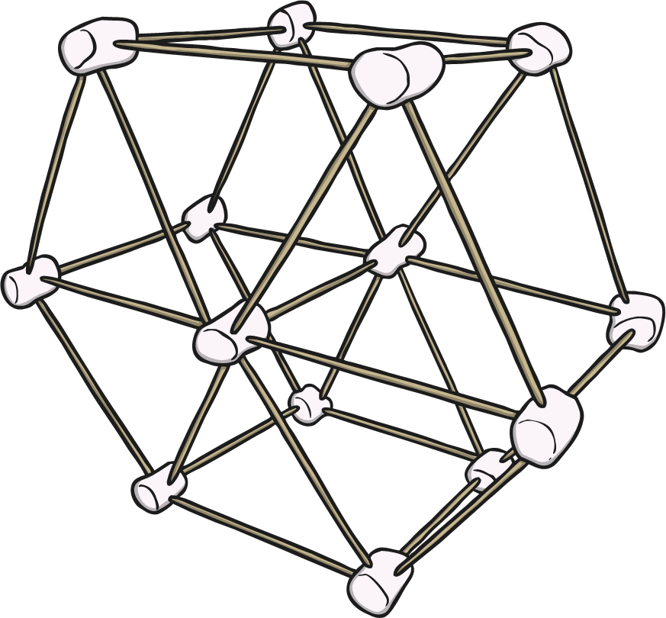
Spaghetti Sculpture
Challenge: To build the tallest sculpture.
You will need:
Spaghetti
Marshmallows
Discuss:
What do you need to think about before you start making your sculpture?
What methods of building can make the tallest and strongest structure?
What makes a stable structure?
What shapes will you need to include within your design?

Slide 3
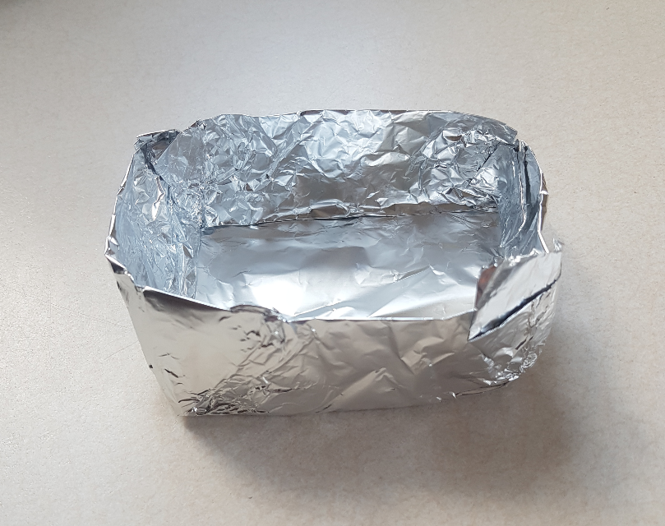
Foil Boat
Challenge: To build a foil boat that can float whilst holding coins.
You will need:
Tin Foil
Coins
Bowl of water
Discuss:
What do you need to think about before you start making your boat?
What does buoyancy mean?
What makes a stable boat?
How do large, heavy ships float?

Slide 4
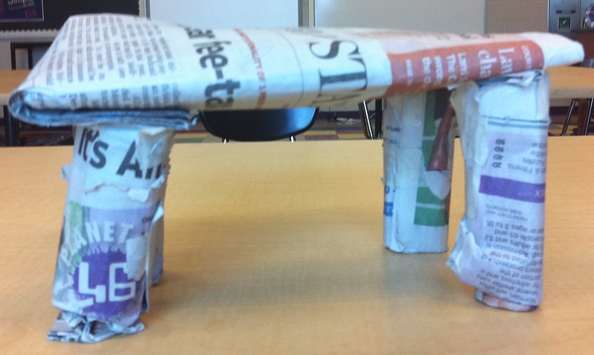
Paper Bridge
Challenge: To build the strongest bridge.
You will need:
Newspaper
Scissors
Tape
Books
Discuss:
What do you need to think about before you start making your bridge?
What makes a stable bridge?
What shapes are you going to consider when designing your bridge?

Slide 5

Colourful Kites
Challenge: To make a colourful kite.
You will need:
A4 coloured paper
Scissors
Thread/string
Stapler
https://www.youtube.com/watch?v=WiPpSI257tw

Slide 6
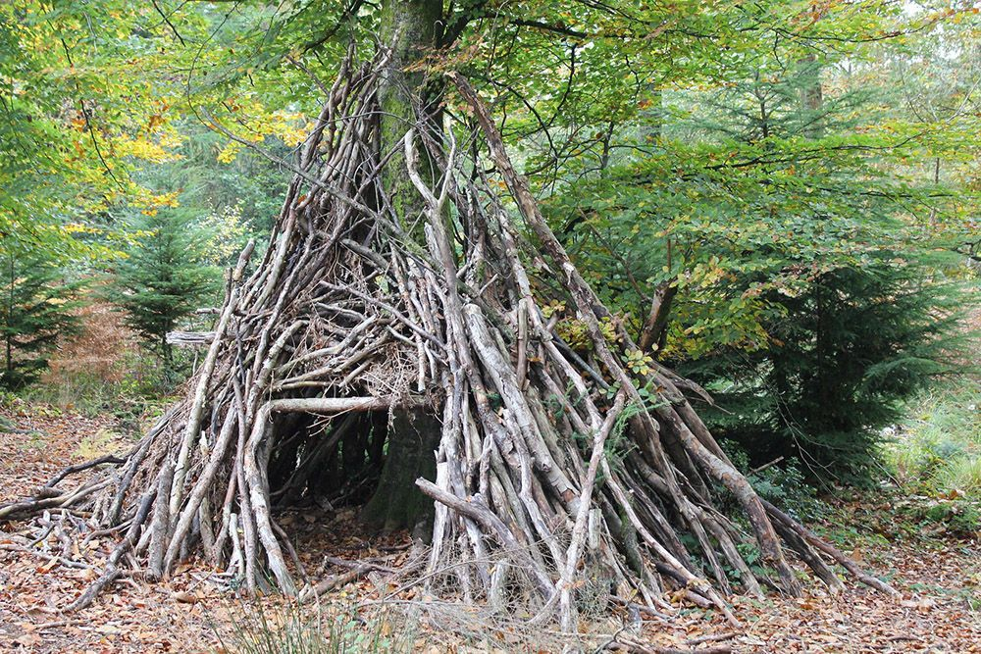
Stick Structure
Challenge: To make a structure out of sticks.
You will need:
Sticks
Discuss:
Will your structure be large or small?
Will your structure have a purpose?
Will your structure be detailed?
Where is the best place to build your structure?
How will your structure stay stable?

Slide 7
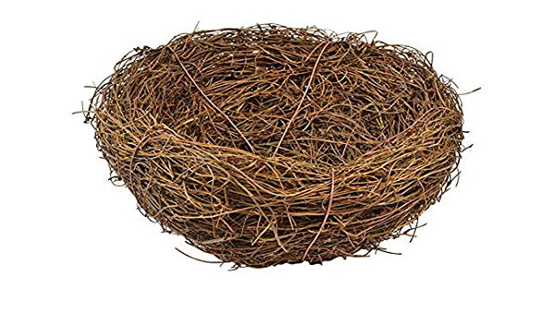
Build a Bird’s Nest
Challenge: To build a bird’s nest.
You will need:
Sticks
Twigs
Leaves
Discuss:
What materials will you use?
How will your nest stay firm and stable?
Where is the best place to build a nest?
Feathers
Leaves
Bark
Grass

Slide 8
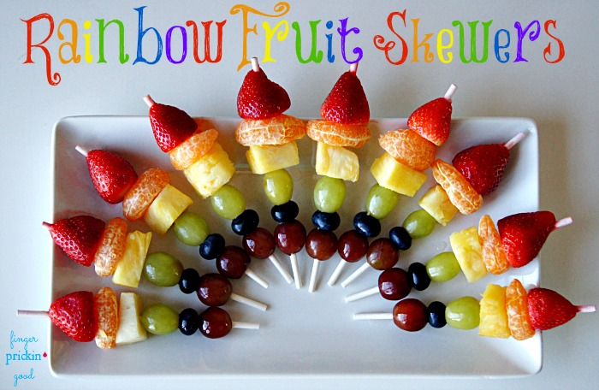
Colourful Fruit Kebabs
Challenge: To make a colourful fruit kebab.
You will need:
Strawberries
Pineapple
Grapes
Blueberries
Satsumas
Wooden skewers
Discuss:
What do you need to think about before you start making your fruit kebab?
What fruit will you use, why?

Slide 9
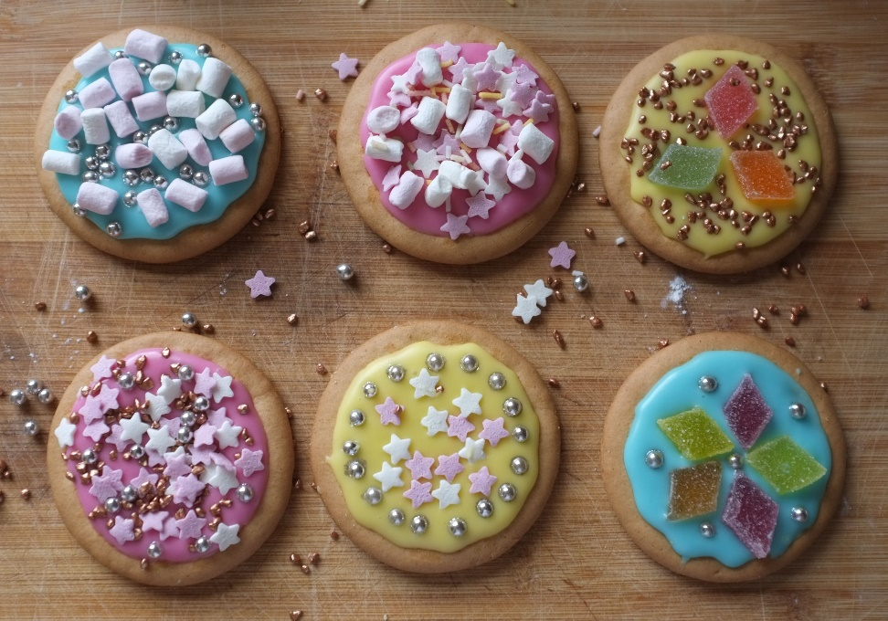
Colourful Biscuits
Challenge: To decorate a biscuit.
You will need:
Rich Tea Biscuits
Edible Toppings e.g. sprinkles
Icing sugar
Discuss:
What do you need to think about before you start decorating your biscuits?
What makes an attractive biscuit?
What design will you choose and why?

