Slide 1

Endangered Animals Day
Notes:
Today is all about supporting our local wildlife and endangered animals that are native to the UK.
Thank you so much for taking part and hopefully donating a small amount to help us raise money for the BBO Wildlife Trust.
We decided to support this charity along with the other Marlow Schools to help make a difference to our local environment and try and save as many endangered animals as possible.

Slide 2
What’s an endangered animal?
Notes:
You might think Eco Schools is just about recycling and picking up litter but it is so much more than that.
Many wildlife species are in danger because of things like pollution, climate change, and loss of habitat.
And wildlife and animals are important because they’re part of a wider natural environment that may provide food, shelter, water, for other wildlife and people.
We can help by supporting charities that protect animals and wildlife like BBO.
But what is an endangered animal?
In the UK we have many species of animals that are considered endangered, that means that a particular species might not continue to exist.
The Water Vole is Britain’s fastest declining mammal. Without the help of charities like BBO and people like us, we might lose water voles forever.

Slide 3
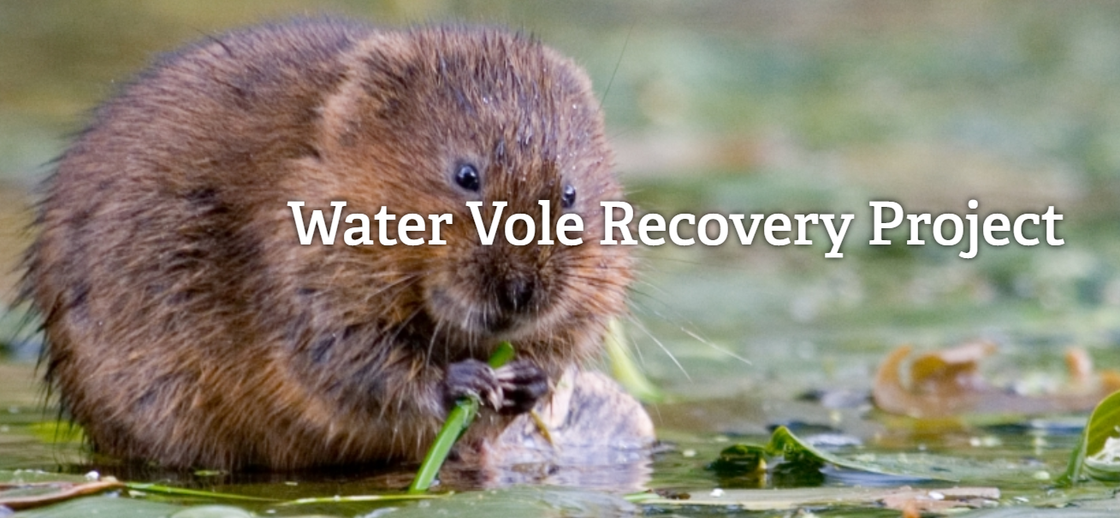
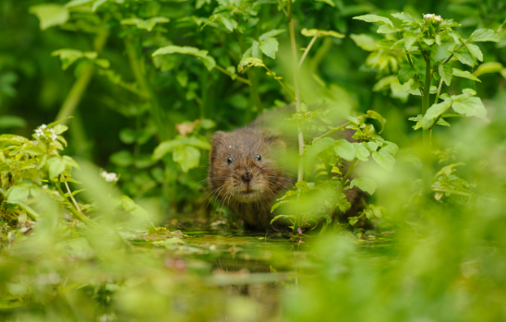
Notes:
BBO is currently working on the water vole recovery project.
The charity is working with local famers to increase and improve local habitat. Your donation today can go towards helping this animal who is in danger of becoming extinct in the UK.
So what other animals are in danger?
Hazel dormouse, red squirrel, otters, tortoiseshell butterflies, hedgehogs, seals, starlings, bats.. To name just a few.

Slide 4
What else are we doing to help?
Notes:
At Burford Mrs Marshall is currently working to develop our wildlife garden and along with the activities that you all took part in during creative week we are all helping to make a difference to our local wildlife. We have a new bug hotel, hedgehog house, log piles and new flowers and plants that attract bees and butterflies.
Mrs Higgins makes sure that Forest School is protected.
We have planted trees.
We all took part in a tree planting project, which hopefully mean more trees get planted soon.
We are supporting BBO with our donations from today.

Slide 5
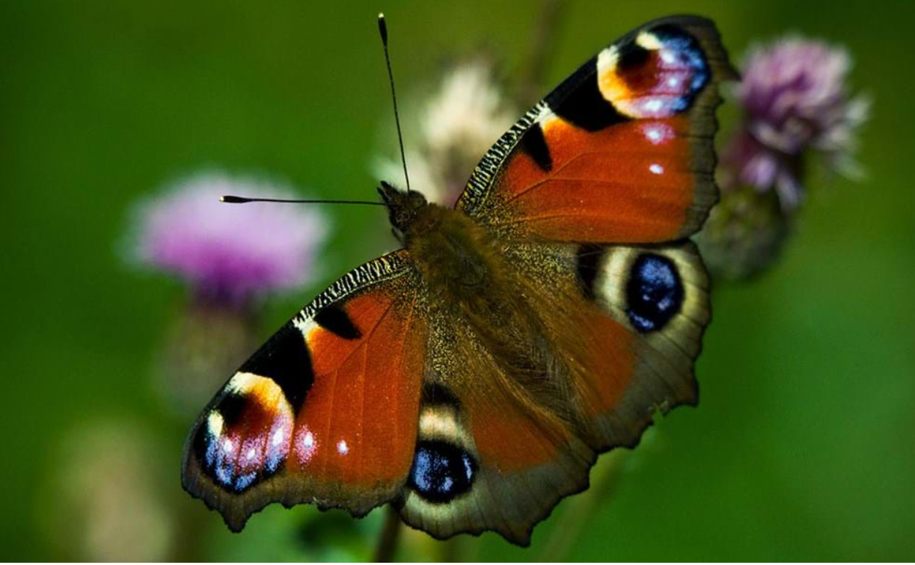
What can you do to help?
Notes:
You could build your own bug hotel.
You could plant wildflower seeds to attract bees and butterflies.
Get outside and go wild!
Visit a nature reserve!

Slide 6
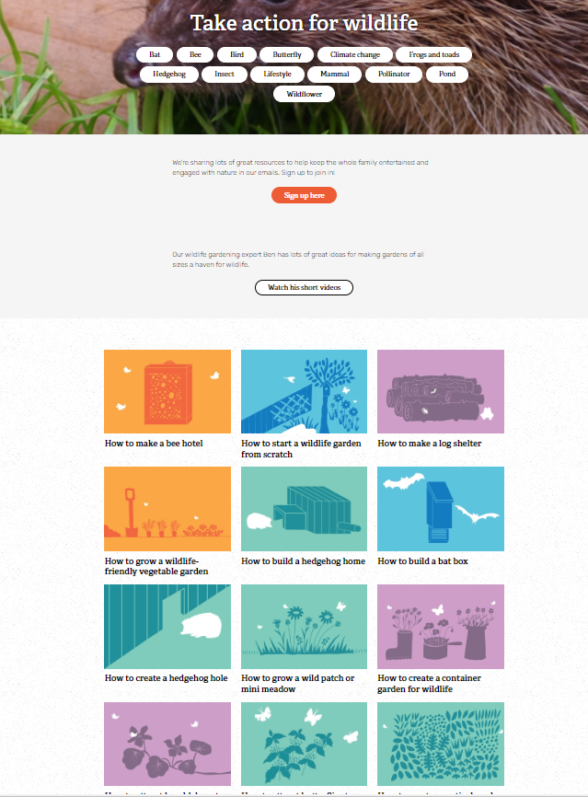
https://www.bbowt.org.uk/wildlife-gardening-videos
Notes:
Look at the BBO website, it has lots of great information and ideas about how you and your family can help look after wildlife and animals.
There are lots of short videos too… let’s finish by watching one about helping hedgehogs.
Video
Thank you for your support today thank you for listening. Mrs Fowler Marsh will put this assembly on the website so that you can share the BBO link with your families if you would like too.
We hope you had fun dressing up!!

